Slide 1
G1 HUMANOID ROBOT
CONTROL SYSTEM ARCHITECTURE
Learning-based locomotion without hand-coded gaits
Dynamic walking, running, and manipulation through AI
https://github.com/unitreerobotics/unitree_rl_gym/blob/main/legged_gym/envs/g1
g1_config.py - Configuration file defining all parameters
g1_env.py - Runtime implementation that uses the configuration

Slide 2
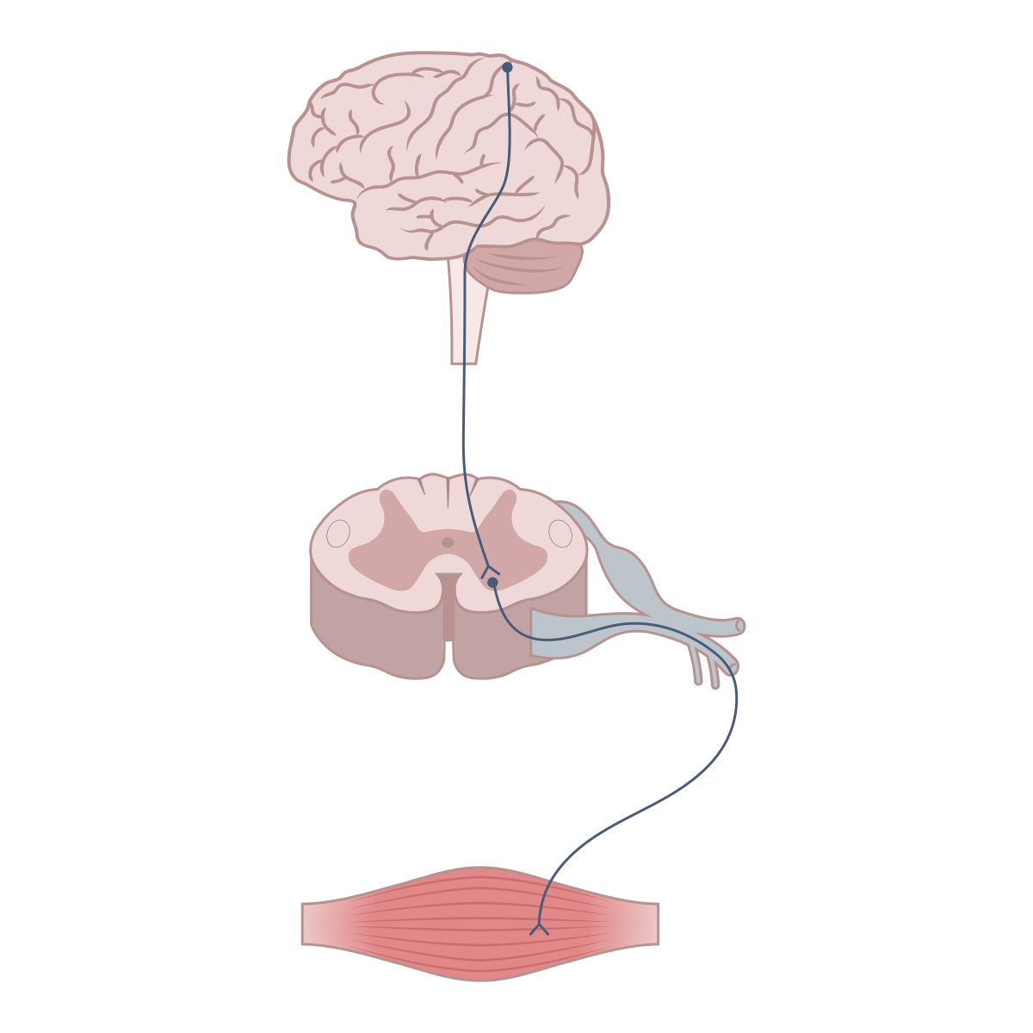
Long short-term memory (LSTM)
PD controllers
Motors: 29 total; 12 lower body
Remembers important things from previous moments
Forgets unimportant details to avoid clutter
Combines old memory with new information to make decisions
Updates its memory for the next timestep
Precise joint tracking: Converts LSTM position targets into motor torques
Error correction: Continuously adjusts for position and velocity deviations
Smooth motion: Prevents jerky movements through velocity damping
Type: Low-inertia PMSM (Permanent Magnet Synchronous Motors)
Peak torque: 120 N⋅m
Design: Hollow-shaft for weight reduction and heat dissipation
Feedback: Dual encoders per joint (position + velocity)

Slide 3
Step 1: Sensing (Every millisecond) : 47 Sensor Readings
S No. | Sensors Readings | Observation Space
1. | base_ang_vel | Body angular velocity vector ω ∈ ℝ³ [rad/s] ωₓ (roll rate), ωᵧ (pitch rate), ωᵤ (yaw rate) | 3
2. | projected_gravity | Gravity vector in body frame g_body ∈ ℝ³ [m/s²] Provides orientation relative to world frame | 3
3. | commands | High-level velocity commands v_cmd ∈ ℝ³ [m/s, m/s, rad/s] Linear velocity (forward, lateral), angular velocity commands | 3
4. | joint_positions | Joint configuration error q_err ∈ ℝ¹² [rad] q_err = q_current - q_default (deviation from nominal stance) | 12
5. | joint_velocities | Joint velocity vector q̇ ∈ ℝ¹² [rad/s] Angular velocities of all actuated degrees of freedom | 12
6. | previous_actions | Prior control input u_{t-1} ∈ ℝ¹² [rad] Previous timestep motor commands for temporal consistency | 12
7. | gait_phase | Periodic timing signals φ ∈ ℝ² [dimensionless] sin(2πφ), cos(2πφ) where φ = (t mod T)/T, T = 0.8s period | 2

Slide 4
Step 2: Memory + Decision (Every 4 milliseconds)
Reward System (Learning Objective)
LSTM processes sensor history
lstm_input = [current_sensors, previous_memory]
lstm_output = lstm_brain.process(lstm_input) # 64 memory units work
Neural network makes decision
decision = neural_network(lstm_output) # 12 joint target positions
Flow: 47 observations → 64-unit LSTM → 32-unit dense layer → 12 actions
class scales( LeggedRobotCfg.rewards.scales ):
tracking_lin_vel = 1.0 # Follow speed commands
tracking_ang_vel = 0.5 # Follow turning commands
orientation = -1.0 # Stay upright
base_height = -10.0 # Maintain proper height (0.78m)
feet_swing_height = -20.0 # Don't drag feet
alive = 0.15 # Bonus for not falling

Slide 5
Step 3: Control (Every millisecond)
# action scale: target angle = actionScale * action + defaultAngle
action_scale = 0.25
target_joint_angle = 0.25 * neural_network_output + default_joint_angle
decimation = 4 # Policy updates every 4 control steps
PD Control Layer:
stiffness = {'hip_yaw': 100, 'hip_roll': 100, 'hip_pitch': 100, 'knee': 150, 'ankle': 40} # [N*m/rad]
damping = {'hip_yaw': 2, 'hip_roll': 2, 'hip_pitch': 2, 'knee': 4, 'ankle': 2} # [N*m*s/rad]
for each_joint:
error = target_position - current_position
torque = Kp * error + Kd * velocity_error
motor.apply_torque(torque)
250Hz: LSTM makes walking decisions
1000Hz: PD controllers execute smooth joint motion
125Hz: Gait phase updates (0.8s per step)

Slide 6
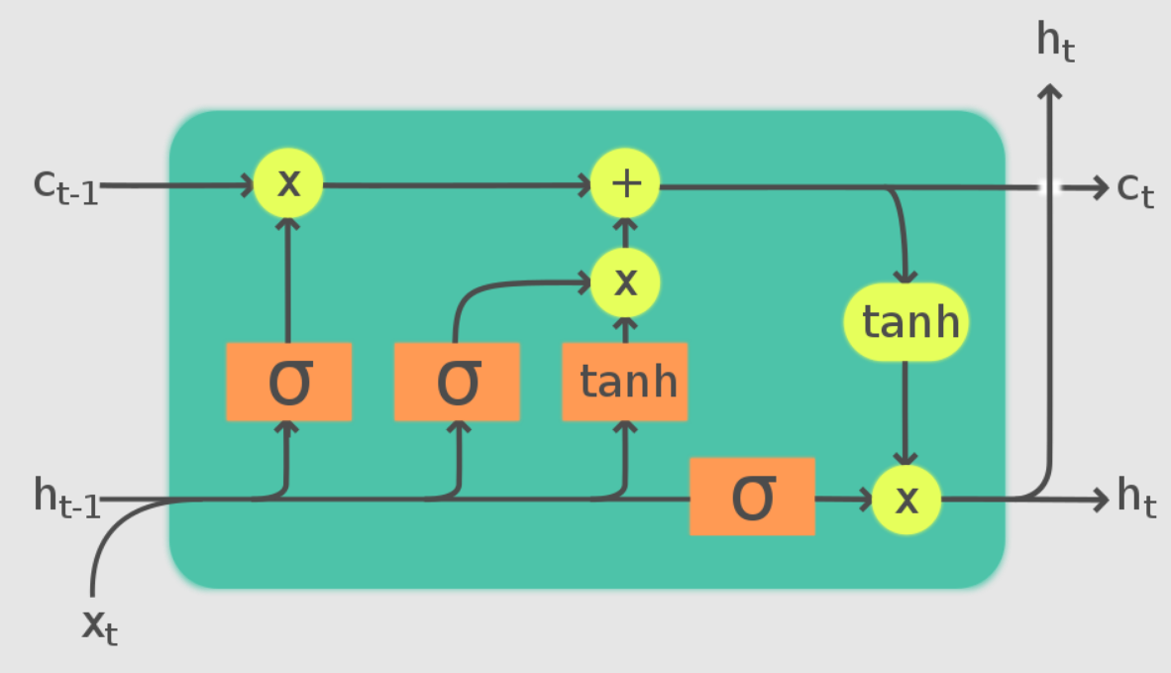
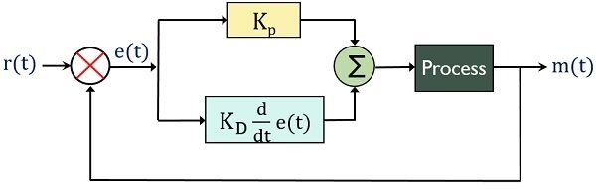
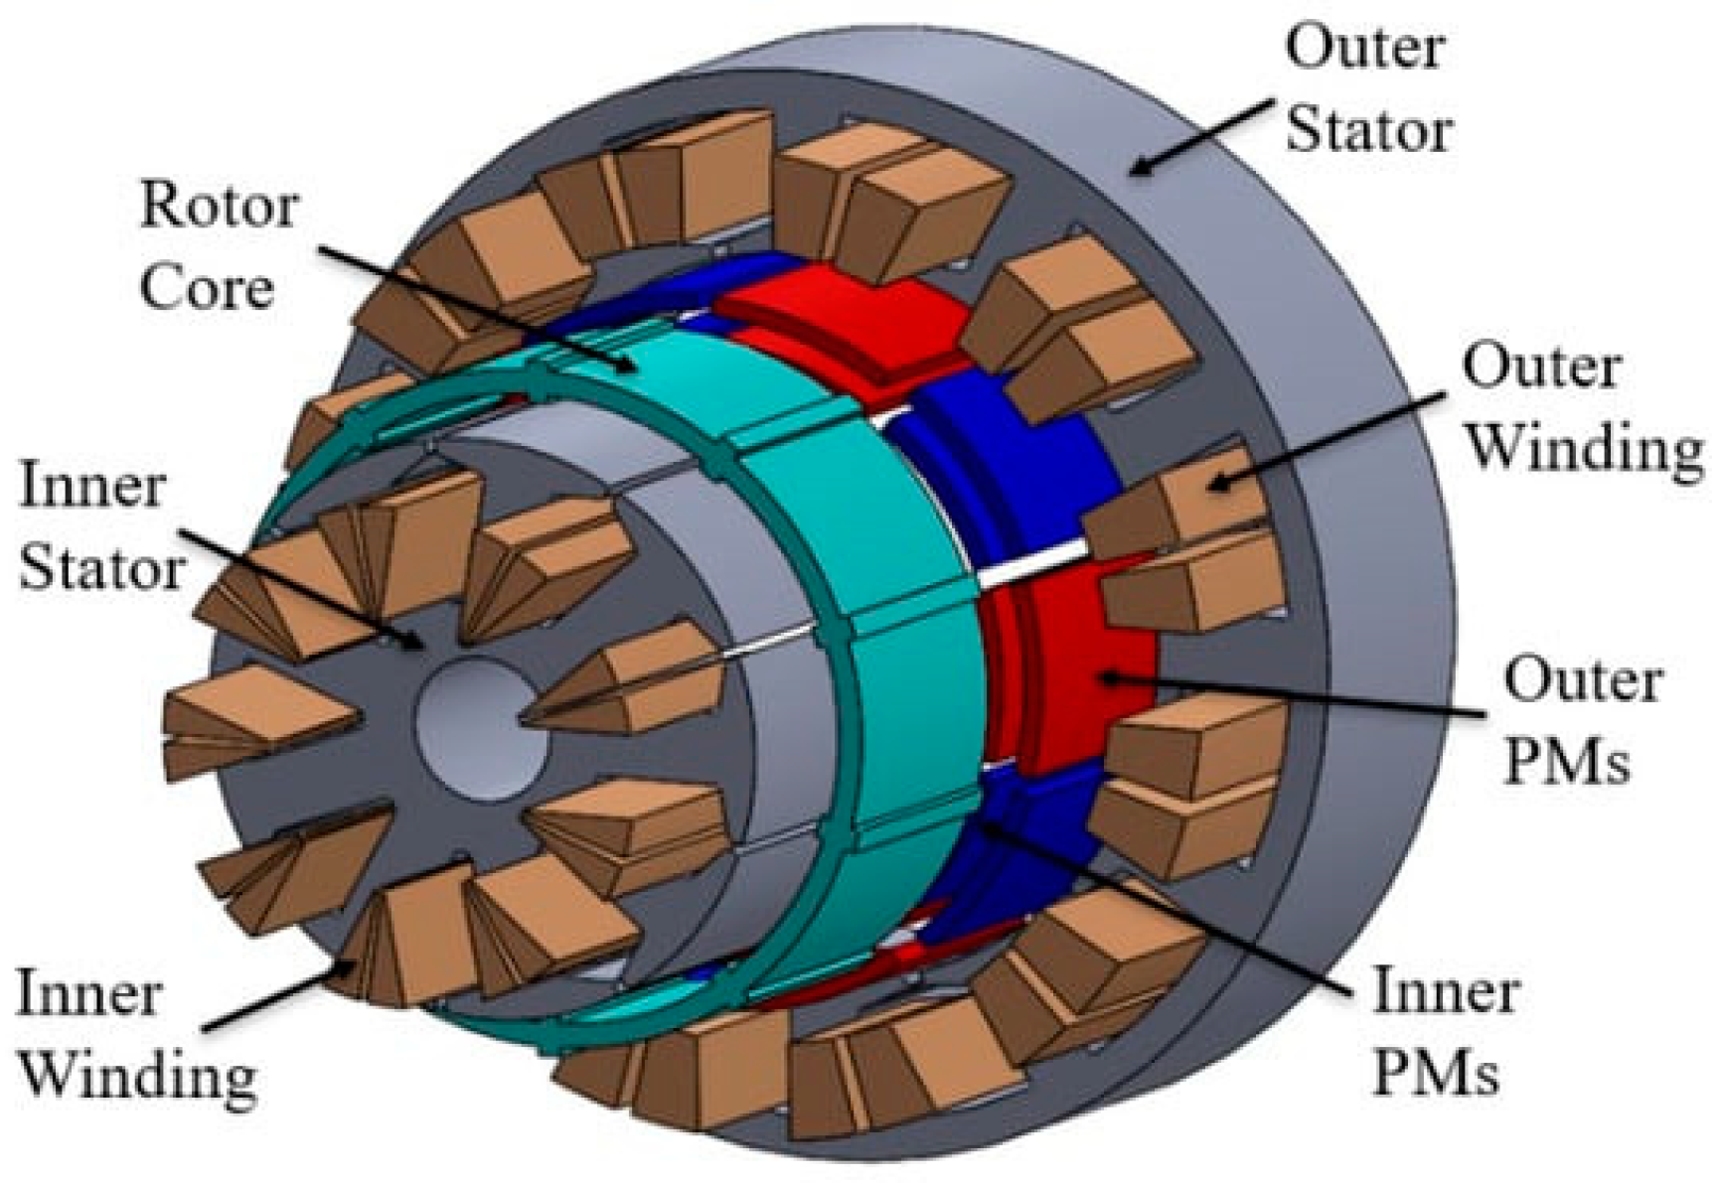
LSTM Neural Network
PD Controller
12 joint
targets
12 motors
Forget Input Output
Gates (0-1)
C = Cell State (Long-term Memory)
H = Hidden State (Working Memory)
X = Input to the LSTM cell at each timestep
PMSM

Slide 7
Force-Position Hybrid Control : Official G1 page
What It Does:
Dual control modes: Switches between position control and force control
Position mode: Precise joint positioning during free motion
Force mode: Controlled force application during contact/manipulation
Automatic switching: Based on contact detection and task requirements
Applications in G1:
Locomotion:
Swing phase: Position control for accurate foot placement
Stance phase: Force control for ground compliance and stability
Terrain adaptation: Force mode allows adaptation to uneven surfaces
Impact absorption: Reduces shock during heel strike
Manipulation (Dex3-1 Hands):
Reaching: Position control for precise hand positioning
Grasping: Force control for safe object handling
Delicate tasks: Prevents damage to fragile objects
Tool operation: Maintains appropriate contact forces

Slide 8
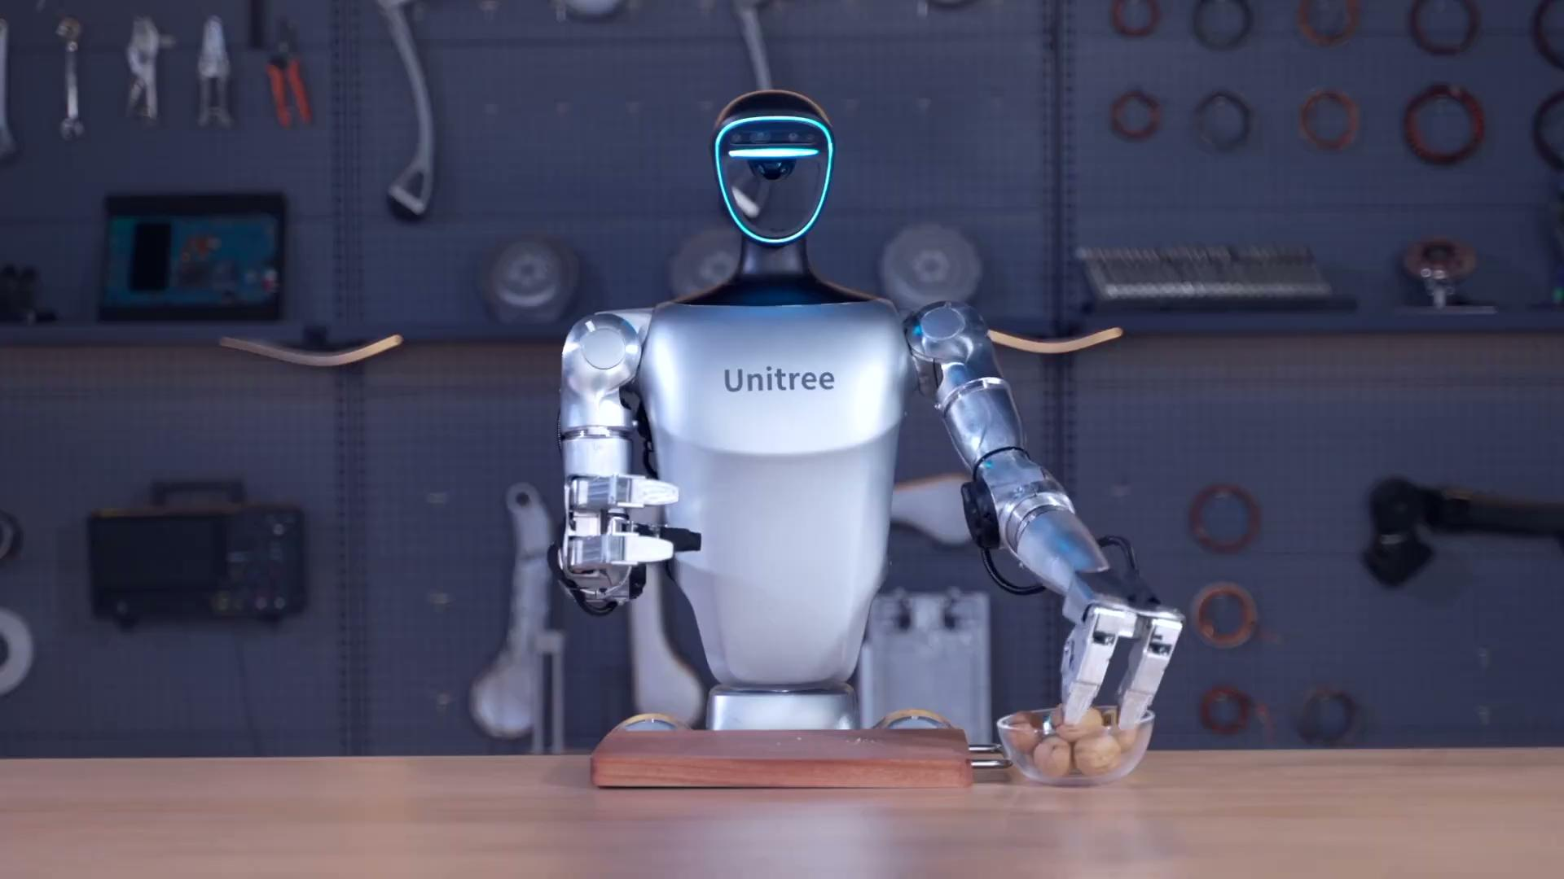
Force-Position Hybrid Control : Black Box
?
Open Research Code: LSTM → PD Controllers → Position Commands
↓
Black Box System: Position Commands → Hybrid Controller → Motor Torques
What we do not know?
1. Exact switching logic between position and force modes?
2. Sensor fusion algorithms for contact detection?
3. Force estimation methods from motor current/encoders?
4. Safety limits and failsafe mechanisms?

Slide 9
G1 Has Multiple Control Systems
1. Production "Black Box" Control (Default)
Location: Runs on the closed control unit (192.168.123.161)
Access: Completely proprietary, no user access
Function: Out-of-the-box walking, balancing, basic behaviors
Type: Unknown algorithms (could be RL, could be traditional control, could be hybrid)
2. Remote Controller Interface
What it does: Sends high-level commands to the production system
Commands: "Walk forward", "Turn left", "Speed up", etc.
Implementation: Controller → WiFi → G1's production algorithms → motor control
3. Research/Development System (GitHub Code)
Location: Runs on development unit (192.168.123.164)
Access: Open source via unitree_rl_gym
Function: Custom trained behaviors, research experiments
Type: The LSTM + RL system we analyzed

Slide 10
Controllers for Simultaneous Locomotion & Manipulation
1. Whole-Body Model Predictive Control (WB-MPC)
Established controller for humanoid robots (used by Boston Dynamics, IHMC)
Optimizes over future time horizon (typically 0.5-2 seconds)
Handles multiple objectives simultaneously through cost function
2. Hierarchical Quadratic Programming (HQP)
Industry standard for whole-body control (used by PAL Robotics, Softbank)
Priority-based task hierarchy (balance > manipulation > locomotion)
Real-time constraint solver
3. Operational Space Control (OSC)
Classic robotics controller by Oussama Khatib (Stanford)
Task-space control instead of joint-space
Handles multiple end-effectors (feet + hands) simultaneously
4. Multi-Contact Model Predictive Control (MC-MPC)
Extension of MPC for multiple contact points
Used by LAAS-CNRS, INRIA for humanoid research
Handles complex contact scenarios

